Slide 1



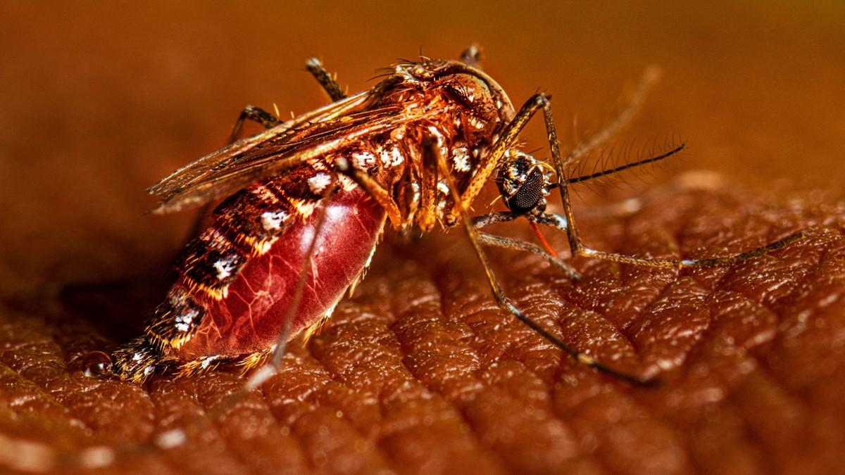


The Burden and Outcome of Dengue-Related Hospitalizations in the United States: An Exploratory Research Project on Dengue Fever
Moses Nyirongo and Bridget Nyamekye

Slide 2
Outline
Introduction
Impact on Population and Public Health
Challenges Associated with Dengue Research
Related Work
Opportunities for Future Research
Conclusion

Slide 3
Introduction
Dengue fever is a mosquito-borne viral disease caused by the dengue virus (DENV) which is transmitted primarily by Aedes mosquitoes.
It represents a major global public health challenge, with approximately 390 million infections annually (Bhatt et al., 2013).
Most infections are mild, but 5–10% progress to severe dengue, which can lead to significant morbidity and mortality (WHO, 2024).
Dengue is increasingly recognized as an emerging concern in the United States due to factors such as international travel, climate change, and the geographic expansion of mosquito vectors .

Slide 4
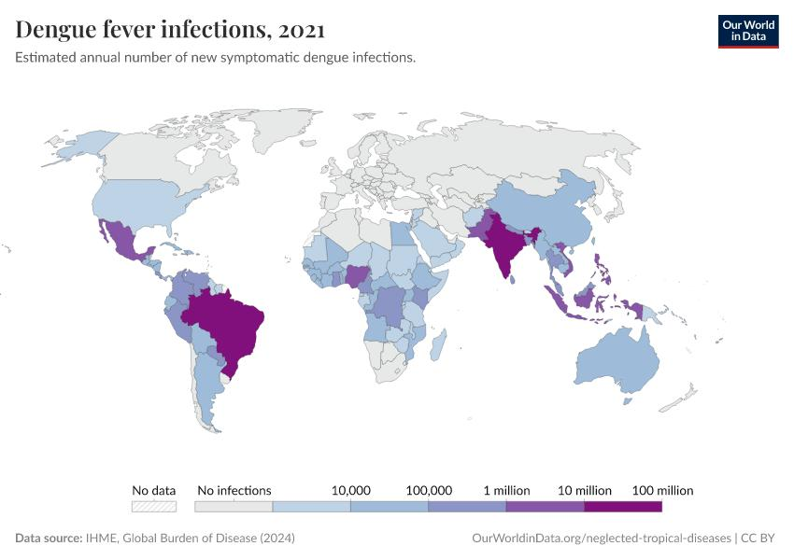

Slide 5
Impact on Population and Public Health
The burden and outcomes of dengue-related hospitalizations in the United States remain poorly characterized, particularly among high-risk populations such as older adults and individuals with comorbidities.
Regions such as Florida, Texas, and Puerto Rico are particularly vulnerable due to favorable environmental conditions.
The burden imposed include:
contributes substantially to morbidity and healthcare utilization, particularly in endemic region
outbreaks result in considerable economic costs due to hospitalization, vector control, and productivity loss
increased risk for adverse outcomes in Vulnerable populations, including older adults and individuals with chronic diseases (Guzman and Harris, 2015).

Slide 6
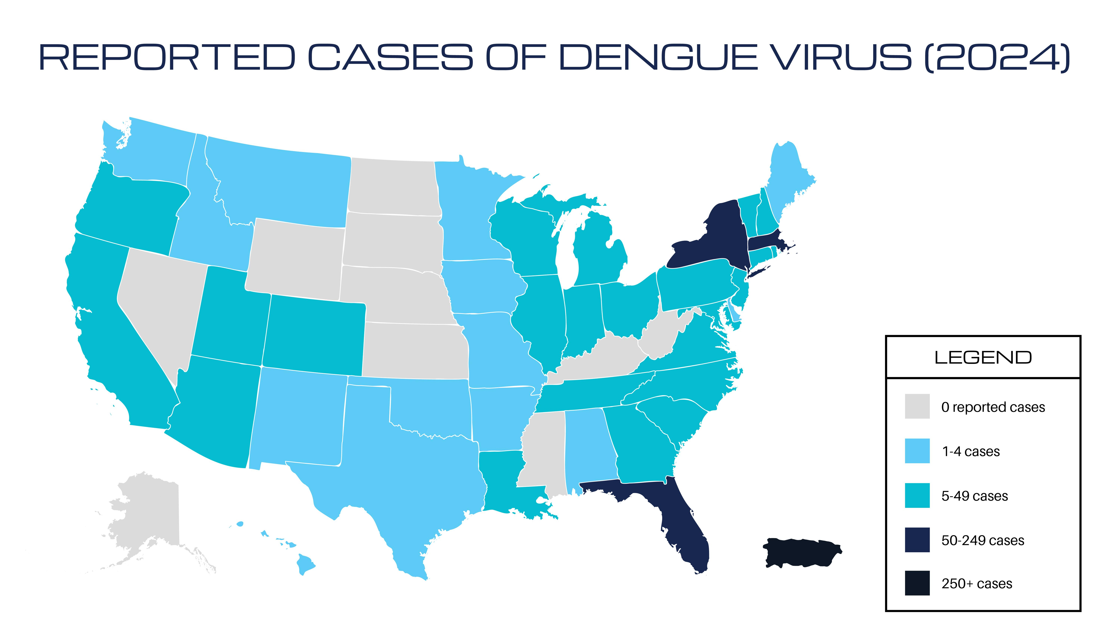

Slide 7
Challenges Associated with Dengue Research
Underreporting and misdiagnosis are common due to symptom overlap with other febrile illnesses (Roy and Bhattacharjee, 2021).
There is limited availability of U.S.-specific data on dengue hospitalizations, with most research focused on endemic countries.
Reliance on administrative data introduces challenges such as coding inaccuracies and misclassification when using ICD-10 diagnostic codes, which may affect the validity of epidemiological estimates.
Climate change which causes environmental unpredictability and expansion of mosquito vectors into new regions complicates efforts to predict dengue transmission patterns (Messina et al., 2019).
Gaps in surveillance systems and data integration hinder real-time monitoring and response

Slide 8
Related Work
Radke et al. (2012) documented local transmission in Florida, highlighting the potential for dengue emergence in the U.S.
Bhatt et al. (2013) provided one of the most comprehensive estimates of global dengue incidence, highlighting significant underreporting in surveillance systems.
Stanaway et al. (2016) quantified the global burden using disability-adjusted life years (DALYs), demonstrating a substantial increase in disease impact over time.
Studies on dengue pathogenesis, such as Roy and Bhattacharjee (2021), have explored the biological mechanisms underlying disease progression and severity.
Note: comprehensive studies examining hospitalization outcomes at a national level in the United States are lacking. Existing literature does not adequately address healthcare utilization, comorbidity profiles, and inpatient outcomes.

Slide 9
Opportunities for Future Research
Enhancing dengue surveillance systems through improved data integration and real-time monitoring - machine learning and predictive analytics offers opportunities for early outbreak detection and risk assessment.
Climate-based modeling to predict the geographic expansion of dengue (Ryan et al., 2019).
U.S.-focused studies to evaluate hospitalization patterns, comorbidity effects, and regional variations
Vaccine effectiveness and therapeutic interventions particularly with emerging transmission in non-endemic regions.

Slide 10
Conclusion
Dengue fever represents an emerging and under-recognized public health threat in the United States. While global research has extensively documented its burden, there remains a significant gap in understanding its impact on the U.S. healthcare system.
As environmental and societal factors continue to evolve, dengue is likely to pose an increasing challenge in the United States. A multidisciplinary approach integrating epidemiology, informatics, and policy will be essential for mitigating its impact and protecting population health.

Slide 11
REFERENCES
AHRQ (2024) Healthcare Cost and Utilization Project (HCUP).
Bhatt, S. et al. (2013) ‘The global distribution and burden of dengue’, Nature, 496(7446), pp. 504–507.
CDC (2024) Dengue in the United States.
Guzman, M.G. and Harris, E. (2015) ‘Dengue’, The Lancet, 385(9966), pp. 453–465.
Messina, J.P. et al. (2019) ‘The current and future global distribution of dengue’, Nature Microbiology, 4(9), pp. 1508–1515.
Radke, E.G. et al. (2012) ‘Dengue outbreak in Key West, Florida’, Emerging Infectious Diseases, 18(1), pp. 135–137.
Roy, S. and Bhattacharjee, B. (2021) ‘Dengue virus: epidemiology, biology and disease aetiology’, Journal of Clinical Virology, 144.
Ryan, S.J. et al. (2019) ‘Global expansion of Aedes-borne virus transmission risk’, PLoS Neglected Tropical Diseases, 13(3).
Shepard, D.S. et al. (2016) ‘The global economic burden of dengue’, The Lancet Infectious Diseases, 16(8), pp. 935–941.
Stanaway, J.D. et al. (2016) ‘The global burden of dengue’, The Lancet Infectious Diseases, 16(6), pp. 712–723.
WHO (2024) Dengue and severe dengue.

